Slide 1
Connect to a Back End with an API Using React Grigori Schneider

Slide 2
Phase 1: User Authentication
Build a completely responsive web application with React.
Use Redux for managing state across the entire application.
Requirements
Users can visit the homepage.
Users can log in to the system.
Users can log out of the system.
Users can only see information related to their own profile after logging in succesfully.
Users can edit the profile and persist the data to the database.

Slide 3
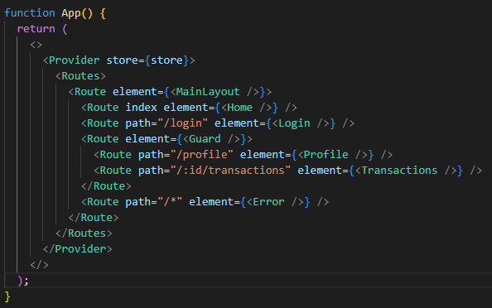
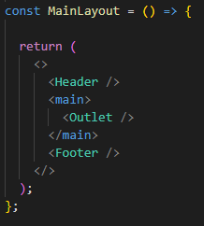
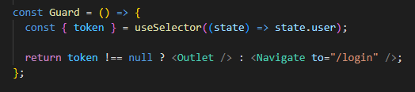
React Router

Slide 4
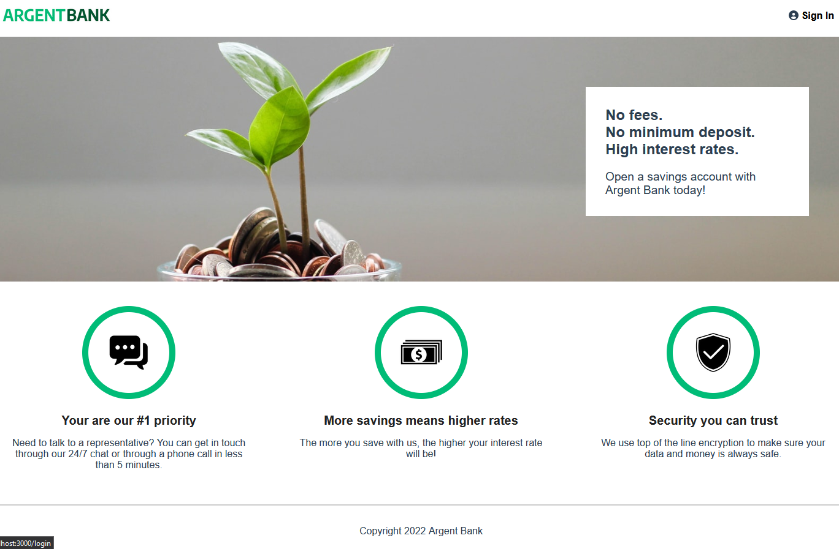
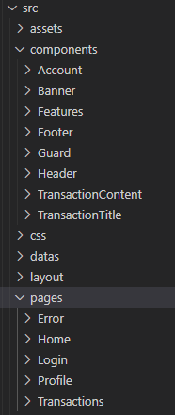
Landing Page
Header
Banner
Features
Footer

Slide 5
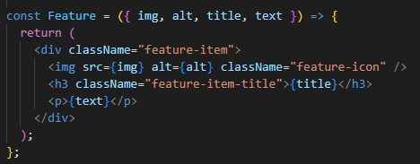
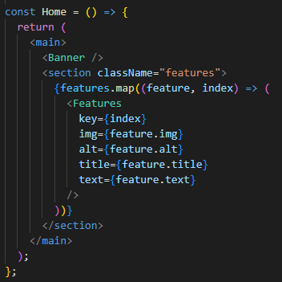
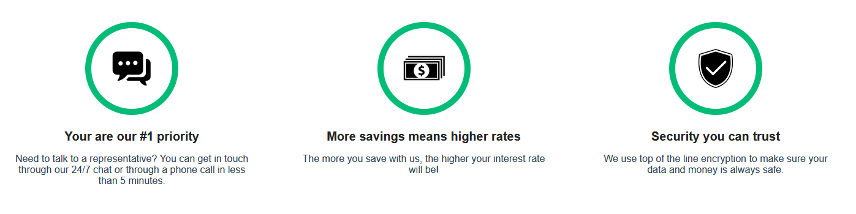
Features Component
Features

Slide 6
Redux Toolkit (RTK)
Redux Toolkit (RTK) simplifies most Redux tasks, prevents common mistakes, and makes it easier to write Redux applications.
createSlice() has one parameter, options. With it we covered properties: name, initialState, and reducers.
A case reducer is a method that can update the state, and will be executed when the corresponding action type is dispatched. This is similar to a case in a switch statement.
You can write code that “mutates” the state inside the case reducers passed to createSlice(), and Immer will safely and accurately return an immutably updated state.
createSlice() returns an object with the following properties: name, reducer, actions, and caseReducers.
RTK has a configureStore() function that simplifies the store setup process. configureStore() wraps around the Redux core createStore() function and the combineReducers() function, and handles most of the store setup for us automatically.

Slide 7
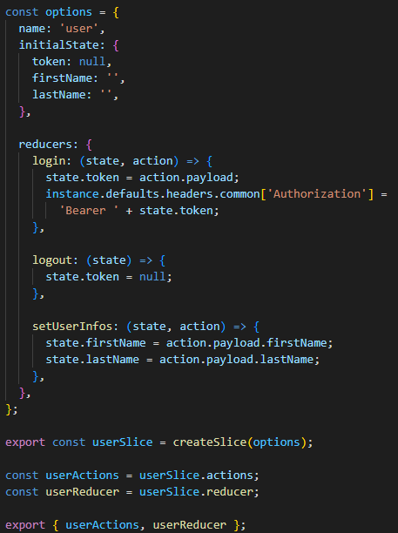
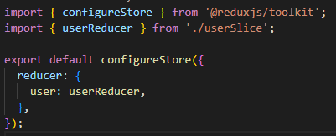
Redux Toolkit (RTK)

Slide 8
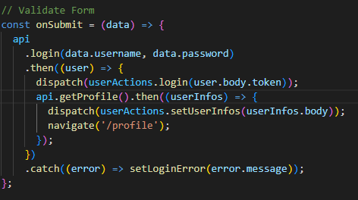
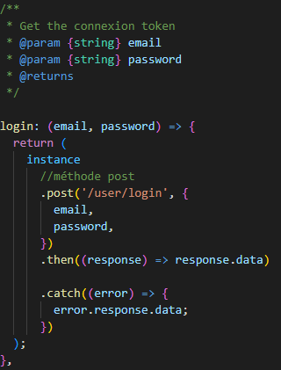
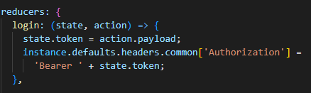
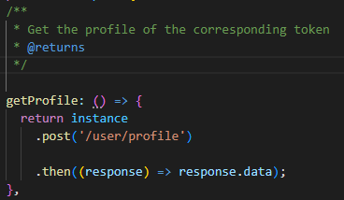
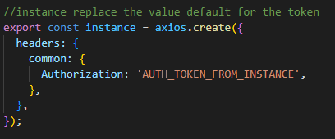
Login
Loging/index
axiosApi
Reducer
axiosApi
axiosApi

Slide 9
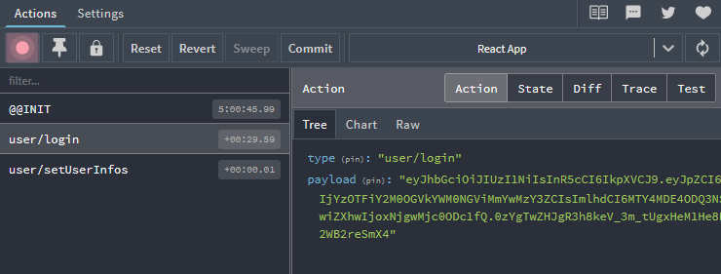
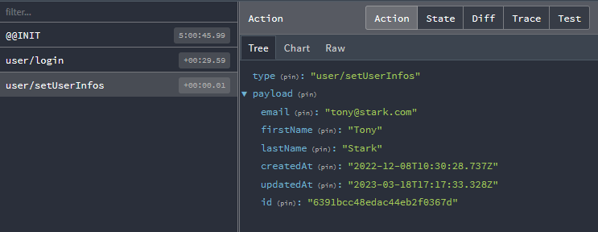
Redux DevTools

Slide 10
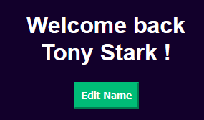
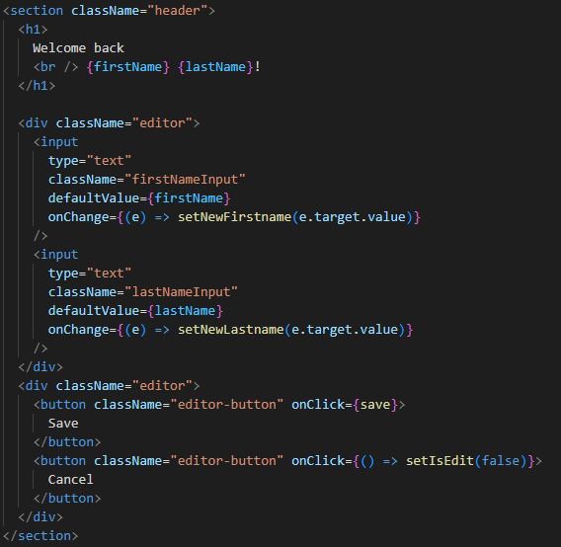
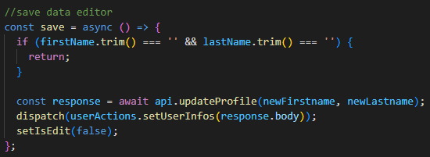
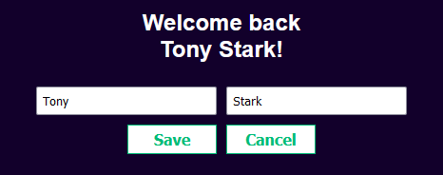
Profile

Slide 11
Phase 2: Transactions
View all of their transactions for the current month.
View additional details of a transaction in an additional view.
Add, change, or remove additional information about a transaction.

Slide 12
Swagger
Swagger is an interface description language for describing APIs
RESTful expressed using JSON.
Swagger is used with a variety of open source software tools to design,
create, document and use RESTful web services.
Used in Back-end, useful in Front-end to know the key elements on each defined endpoint

Slide 13

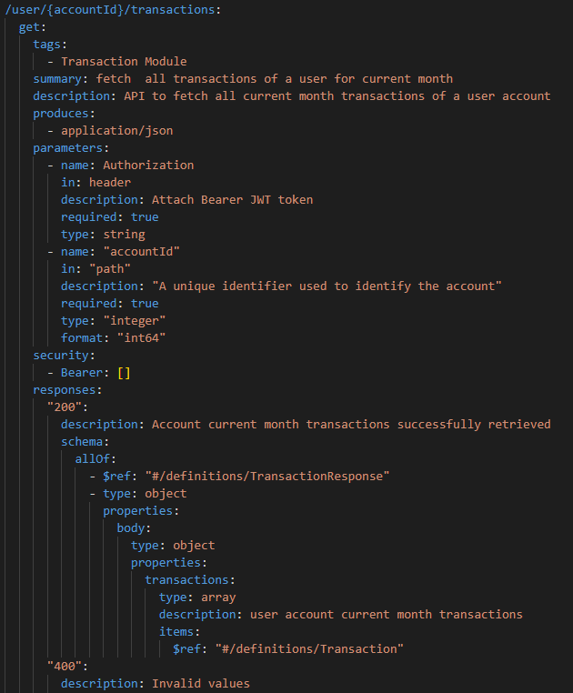
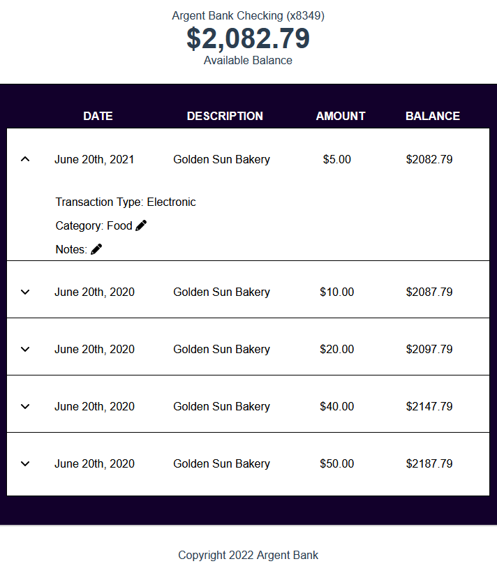
Transaction
Swagger

Slide 14
Thank you!
Q&A

